Slide 1
mcr ROCker model prep
April 28th, 2022
Roth Conrad

Slide 2
For those about to ROC
(pre-ROCin workflow)
(learn about published mcr genes)

Slide 3
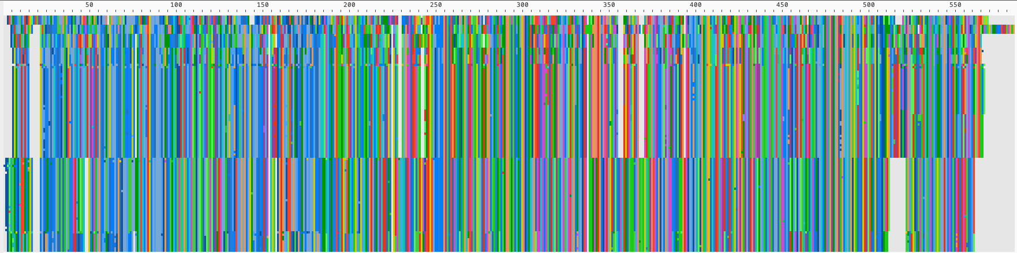
MCR-5.2_Escherichia_coli
MCR-5.4_hospital_metagenome
MCR-5.1_Proteobacteria
MCR-5.3_Escherichia_coli
MCR-8.2_Klebsiella
MCR-8.3_Klebsiella_pneumoniae
MCR-8.1_Enterobacteriaceae
MCR-8.4_Raoultella_ornithinolytica
MCR-4.3_Gammaproteobacteria
MCR-4.6_Enterobacterales
MCR-4.4_Escherichia_coli
MCR-4.5_Escherichia_coli
MCR-4.1_Enterobacteriaceae
MCR-4.2_Enterobacteriaceae
MCR-9.1_Escherichia_coli
MCR-9.2_Enterobacter_roggenkampii
MCR-9.3_Klebsiella_pneumoniae
MCR-10.2_Enterobacter_kobei_A
MCR-10.4_Enterobacter_ludwigii
MCR-10.1_Enterobacteriaceae
MCR-10.3_Enterobacter_kobei_B
MCR-7.1_Klebsiella_pneumoniae
MCR-3.17_Aeromonas
MCR-3.21_Enterobacteriaceae
MCR-3.26_Klebsiella_pneumoniae
MCR-3.5_Enterobacteriaceae
MCR-3.39_Enterobacteriaceae
MCR-3.40_Klebsiella_pneumoniae
MCR-3.28_Klebsiella_pneumoniae
MCR-3.29_Escherichia_coli
MCR-3.11_Enterobacteriaceae
MCR-3.24_Escherichia_coli
MCR-3.2_Enterobacteriaceae
MCR-3.23_Klebsiella_pneumoniae
MCR-3.22_Klebsiella
MCR-3.19_Enterobacteriaceae
MCR-3.4_Enterobacteriaceae
MCR-3.1_Enterobacteriaceae
MCR-3.20_Enterobacteriaceae
MCR-3.9_Aeromonas_hydrophila
MCR-3.10_Aeromonas_caviae
MCR-3.7_Aeromonas_media
MCR-3.12_Escherichia_coli
MCR-3.38_Aeromonas_caviae
MCR-3.27_Aeromonas
MCR-3.15_Aeromonas_media
MCR-3.31_uncultured_bacterium
MCR-3.32_uncultured_bacterium
MCR-3.6_Aeromonas
MCR-3.34_Aeromonas_jandaei
MCR-3.35_Aeromonas_jandaei
MCR-3.33_Aeromonas_jandaei
MCR-3.14_Aeromonas_bivalvium
MCR-3.37_Aeromonas_veronii
MCR-3.25_Aeromonas_veronii
MCR-3_Aeromonas_veronii
MCR-3.36_Aeromonas_jandaei
MCR-3.13_Aeromonas_caviae
MCR-3.8_Aeromonas_hydrophila
MCR-3.18_Aeromonas_caviae
MCR-3.3_Aeromonas
MCR-3.16_Aeromonas
MCR-1.24_Escherichia_coli
MCR-1.23_Salmonella_enterica
MCR-1.10_Moraxella_sp._MSG13-C03
MCR-1.11_Escherichia_coli
MCR-1.32_Escherichia_coli
MCR-1.25_Escherichia_coli
MCR-1.15_Klebsiella_pneumoniae
MCR-1.31_Escherichia_coli
MCR-1.30_uncultured_bacterium
MCR-1.29_uncultured_bacterium
MCR-1.28_Escherichia_coli
MCR-1_Escherichia_coli_B
MCR-1.22_Escherichia_coli
MCR-1.21_Escherichia_coli
MCR-1.20_Escherichia_coli
MCR-1.17_Escherichia_coli
MCR-1.16_Escherichia_coli
MCR-1.19_Salmonella_enterica
MCR-1.13_Escherichia_coli
MCR-1.14_Klebsiella_pneumoniae
MCR-1.18_Escherichia_coli
MCR-1.12_Escherichia_coli
MCR-1.9_Escherichia_coli
MCR-1.8_Escherichia_coli
MCR-1.7_Escherichia_coli
MCR-1.6_Salmonella_enterica
MCR-1.3_Escherichia_coli
MCR-1.4_Escherichia_coli
MCR-1.5_Enterobacteriaceae
MCR-1.2_Enterobacteriaceae
MCR-1_Escherichia_coli_A
MCR-1.1_Gammaproteobacteria
MCR-6.1_Moraxella_sp._MSG47-C17
MCR-2.4_uncultured_bacterium
MCR-2.3_Enterobacteriaceae
MCR-2.5_uncultured_bacterium
MCR-2.7_uncultured_bacterium
MCR-2.1_Escherichia_coli
MCR-2.8_Escherichia_coli
MCR-2.2_Moraxella_pluranimalium
MCR-2.6_uncultured_bacterium
Sequence Order
Multiple Sequence Alignment

Slide 4
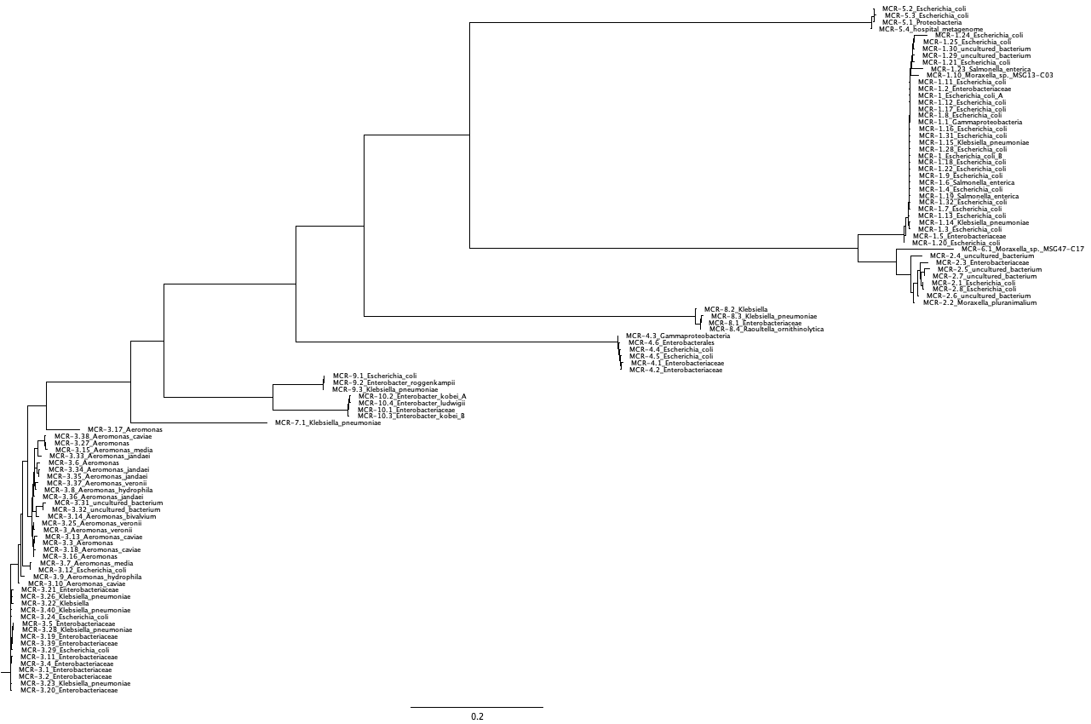
Neighbour-joining tree w/
Distance correction and gaps excluded

Slide 5
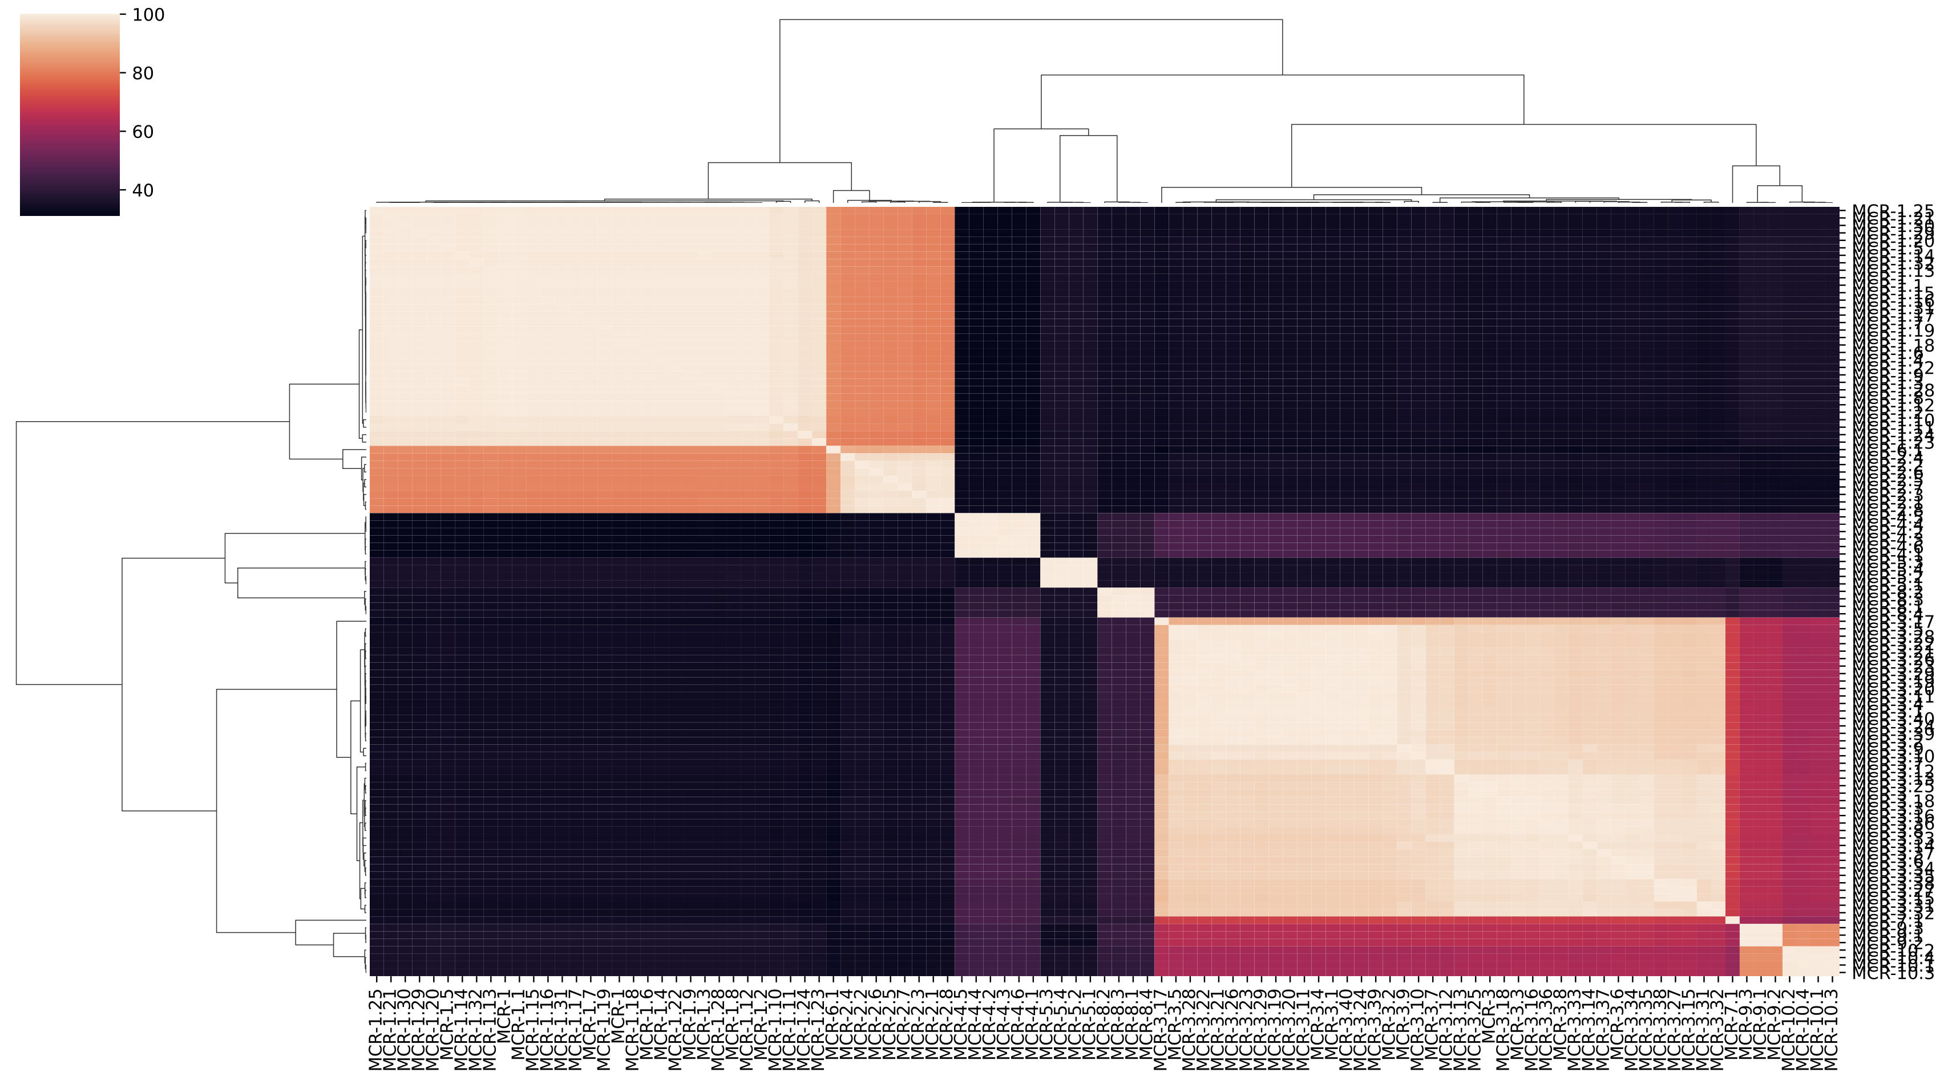
Clustered heatmap from sequence
percent identity matrix (PIM)
mcr-1
mcr-6
mcr-2
mcr-4
mcr-5
mcr-8
mcr-3
mcr-3
mcr-7
mcr-10
mcr-9

Slide 6
ROCin
(you have to ROCin before you can ROCout)
(learn about mcr sequence diversity)

Slide 7
Blast search UniProtkb programmatically using EBI webservices.
Returns UniProt IDs of blast matches.
Retrieve .dat file for each ID using dbfetch.
Includes sequence, species name, taxonomy, reviewed status, and functional annotation.
Parse .dat to fasta format using custom Python script.
Places species, function, status, taxonomy in defline for downstream use.
Build a tree.
Deduplicate sequences by UniProt ID using custom Python script.
Filter sequences using Blastp and custom Python script.
Cluster sequences at 90% amino acid similarity and select reps using mmseqs2.
Multiple sequence alignment with Clustal Omega. (View with AliView or other).
Trim multiple sequence alignment with TrimAL. (View with AliView or other).
Compute the phylogenetic tree with RAxML. (View with FastTree or other).
Build a tsv using custom Python script. (View with Excel or other).
Generate distance matrix from phylogenetic tree newick file.
Cluster distance matrix with HDBSCAN and KMEANS.
Retrieve species, function, status, taxonomy from fasta deflines.

Slide 8
mcr gene results
Sequence curation:
103 mcr seqs in 10 classes from ncbi refgene database.
Selected 1 sequence from each class.
Sequence search:
Returned 1000 hits for each of 10 sequences from UniProt search.
Deduplication retained 3,775 matches.
Filtering did not remove any matches.
Clustering at 90% aa paired down to 1110 sequences.
1 sequence removed by TrimAl during alignment trimming.

Slide 9
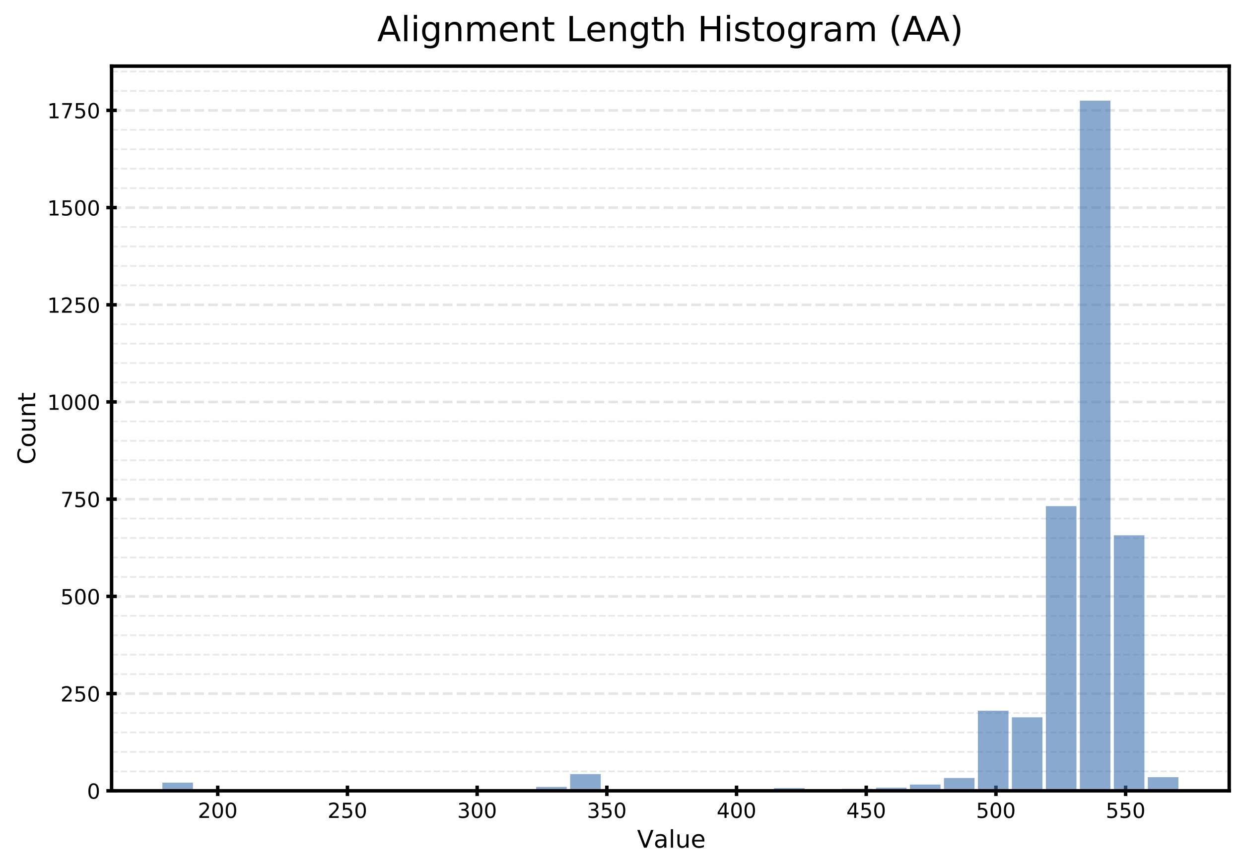
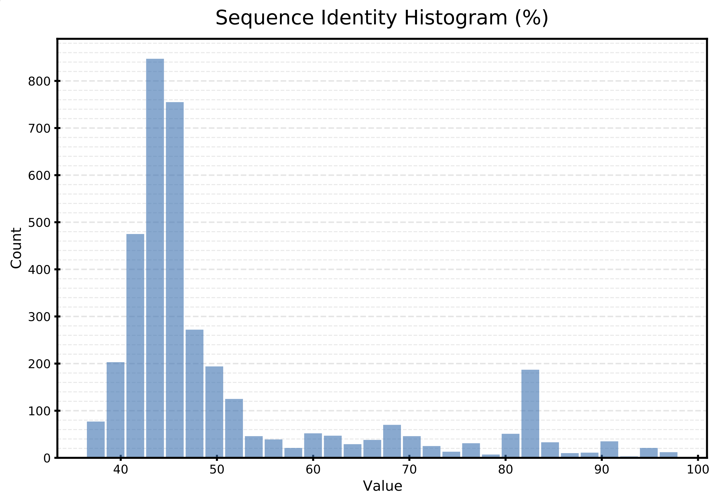
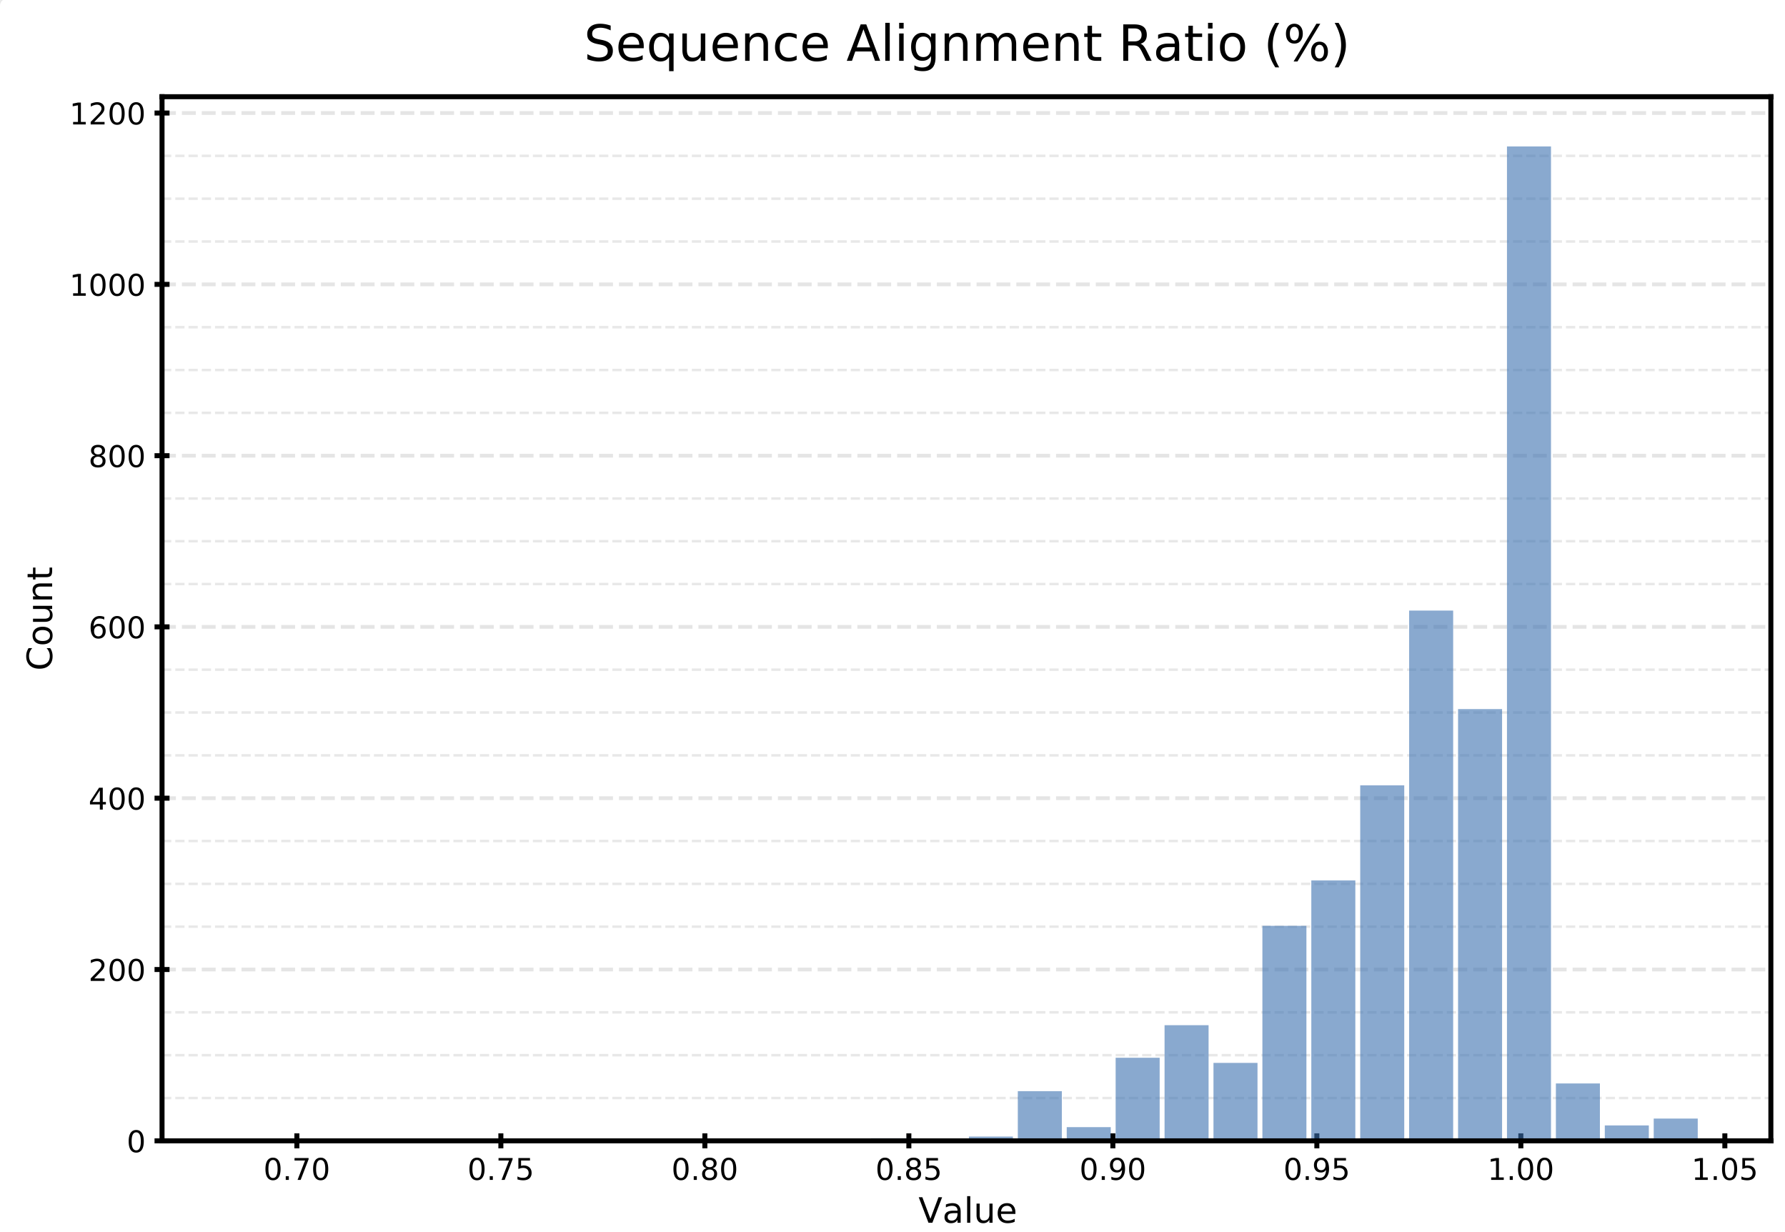
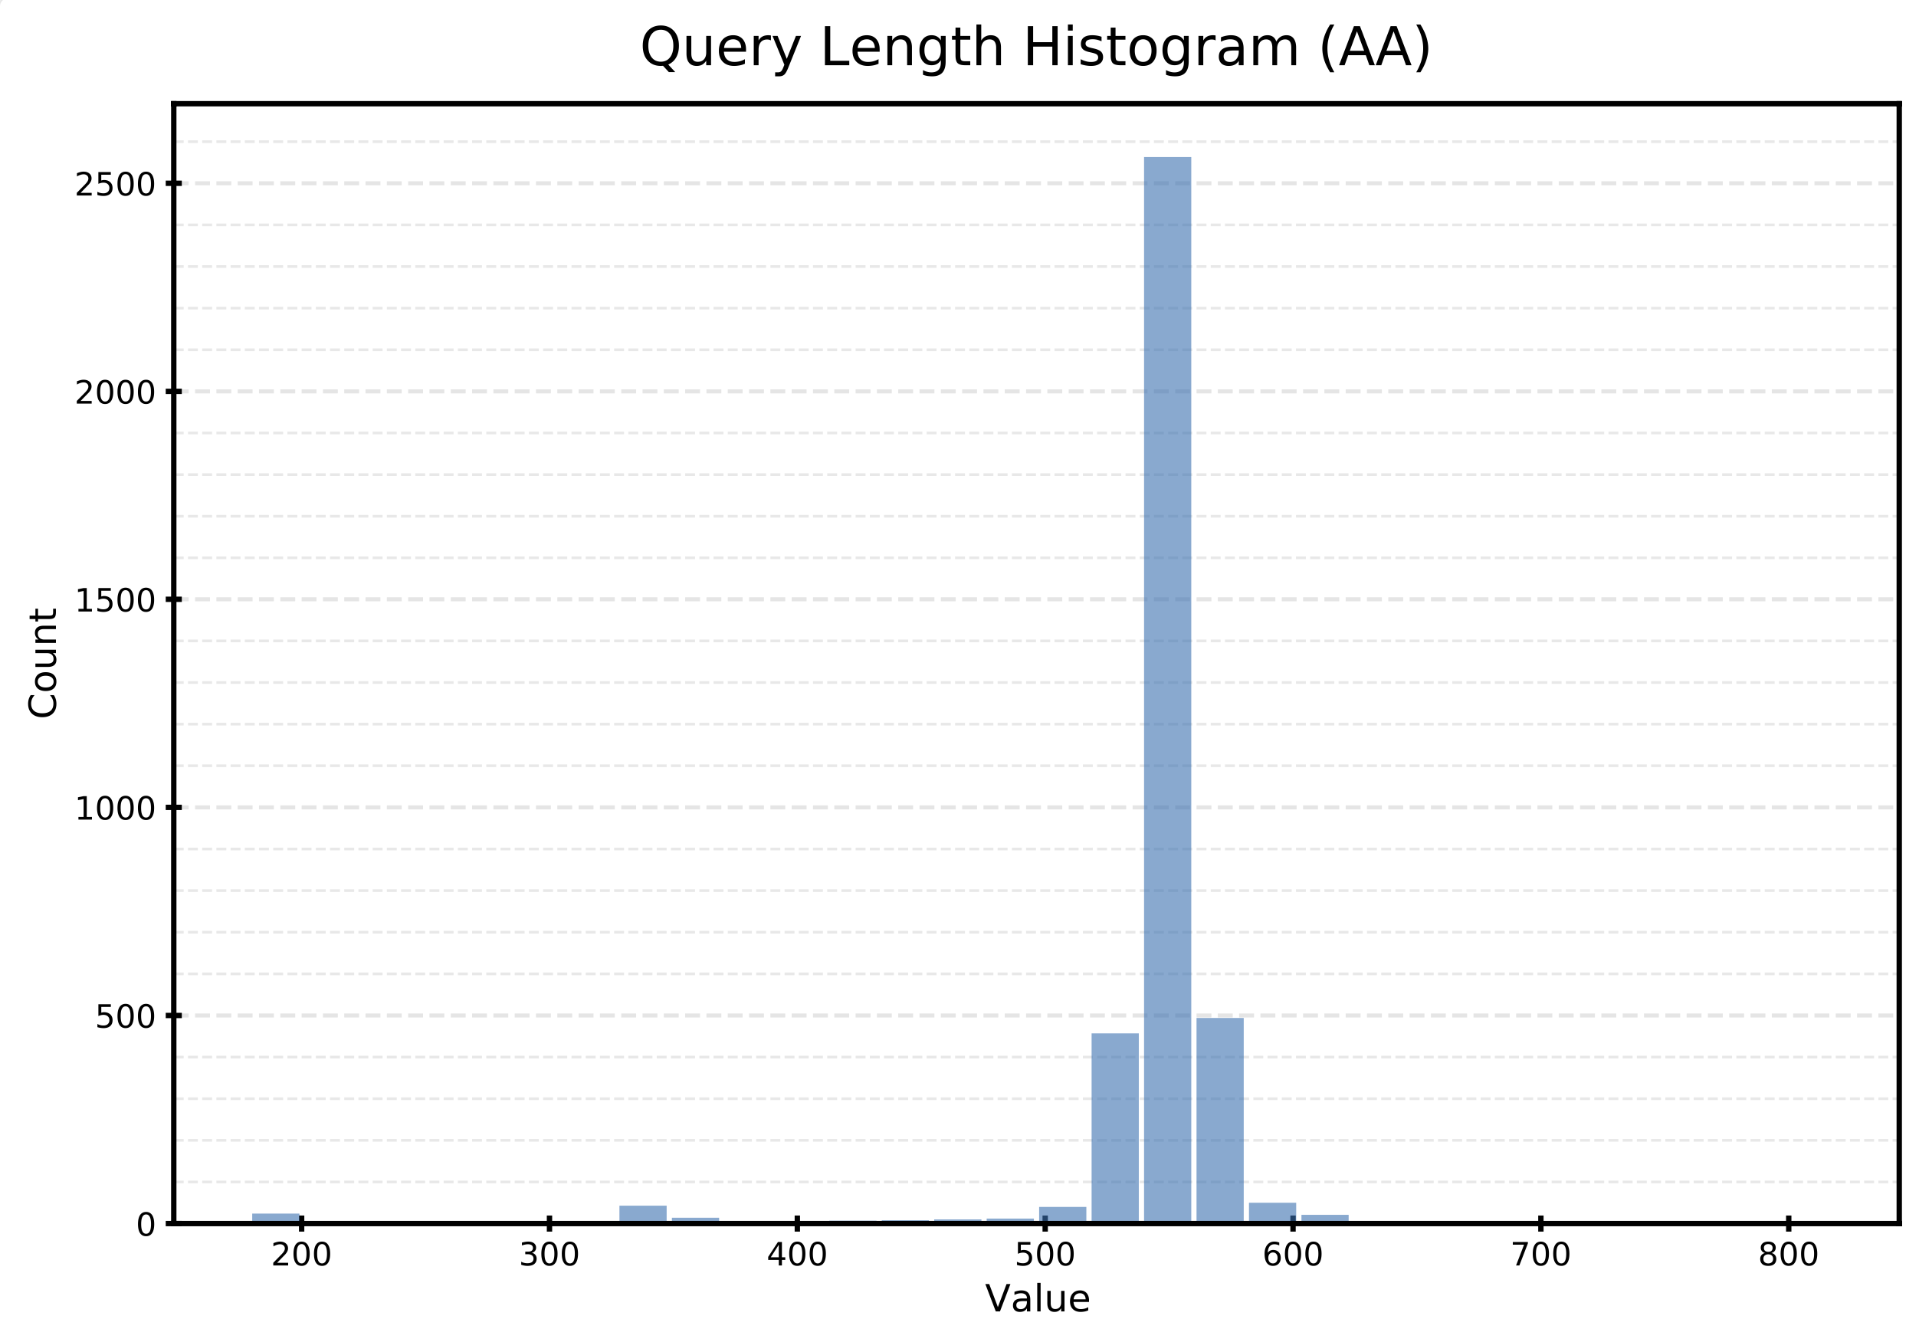
Blastp/filter
Results

Slide 10
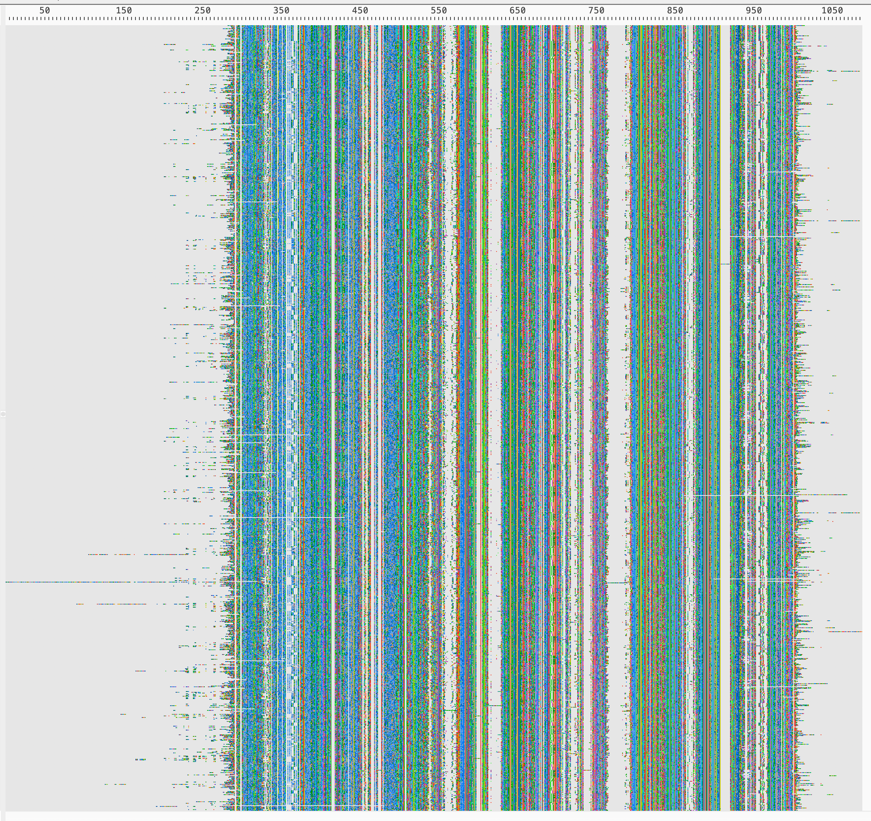
Alignment pre-trimming

Slide 11
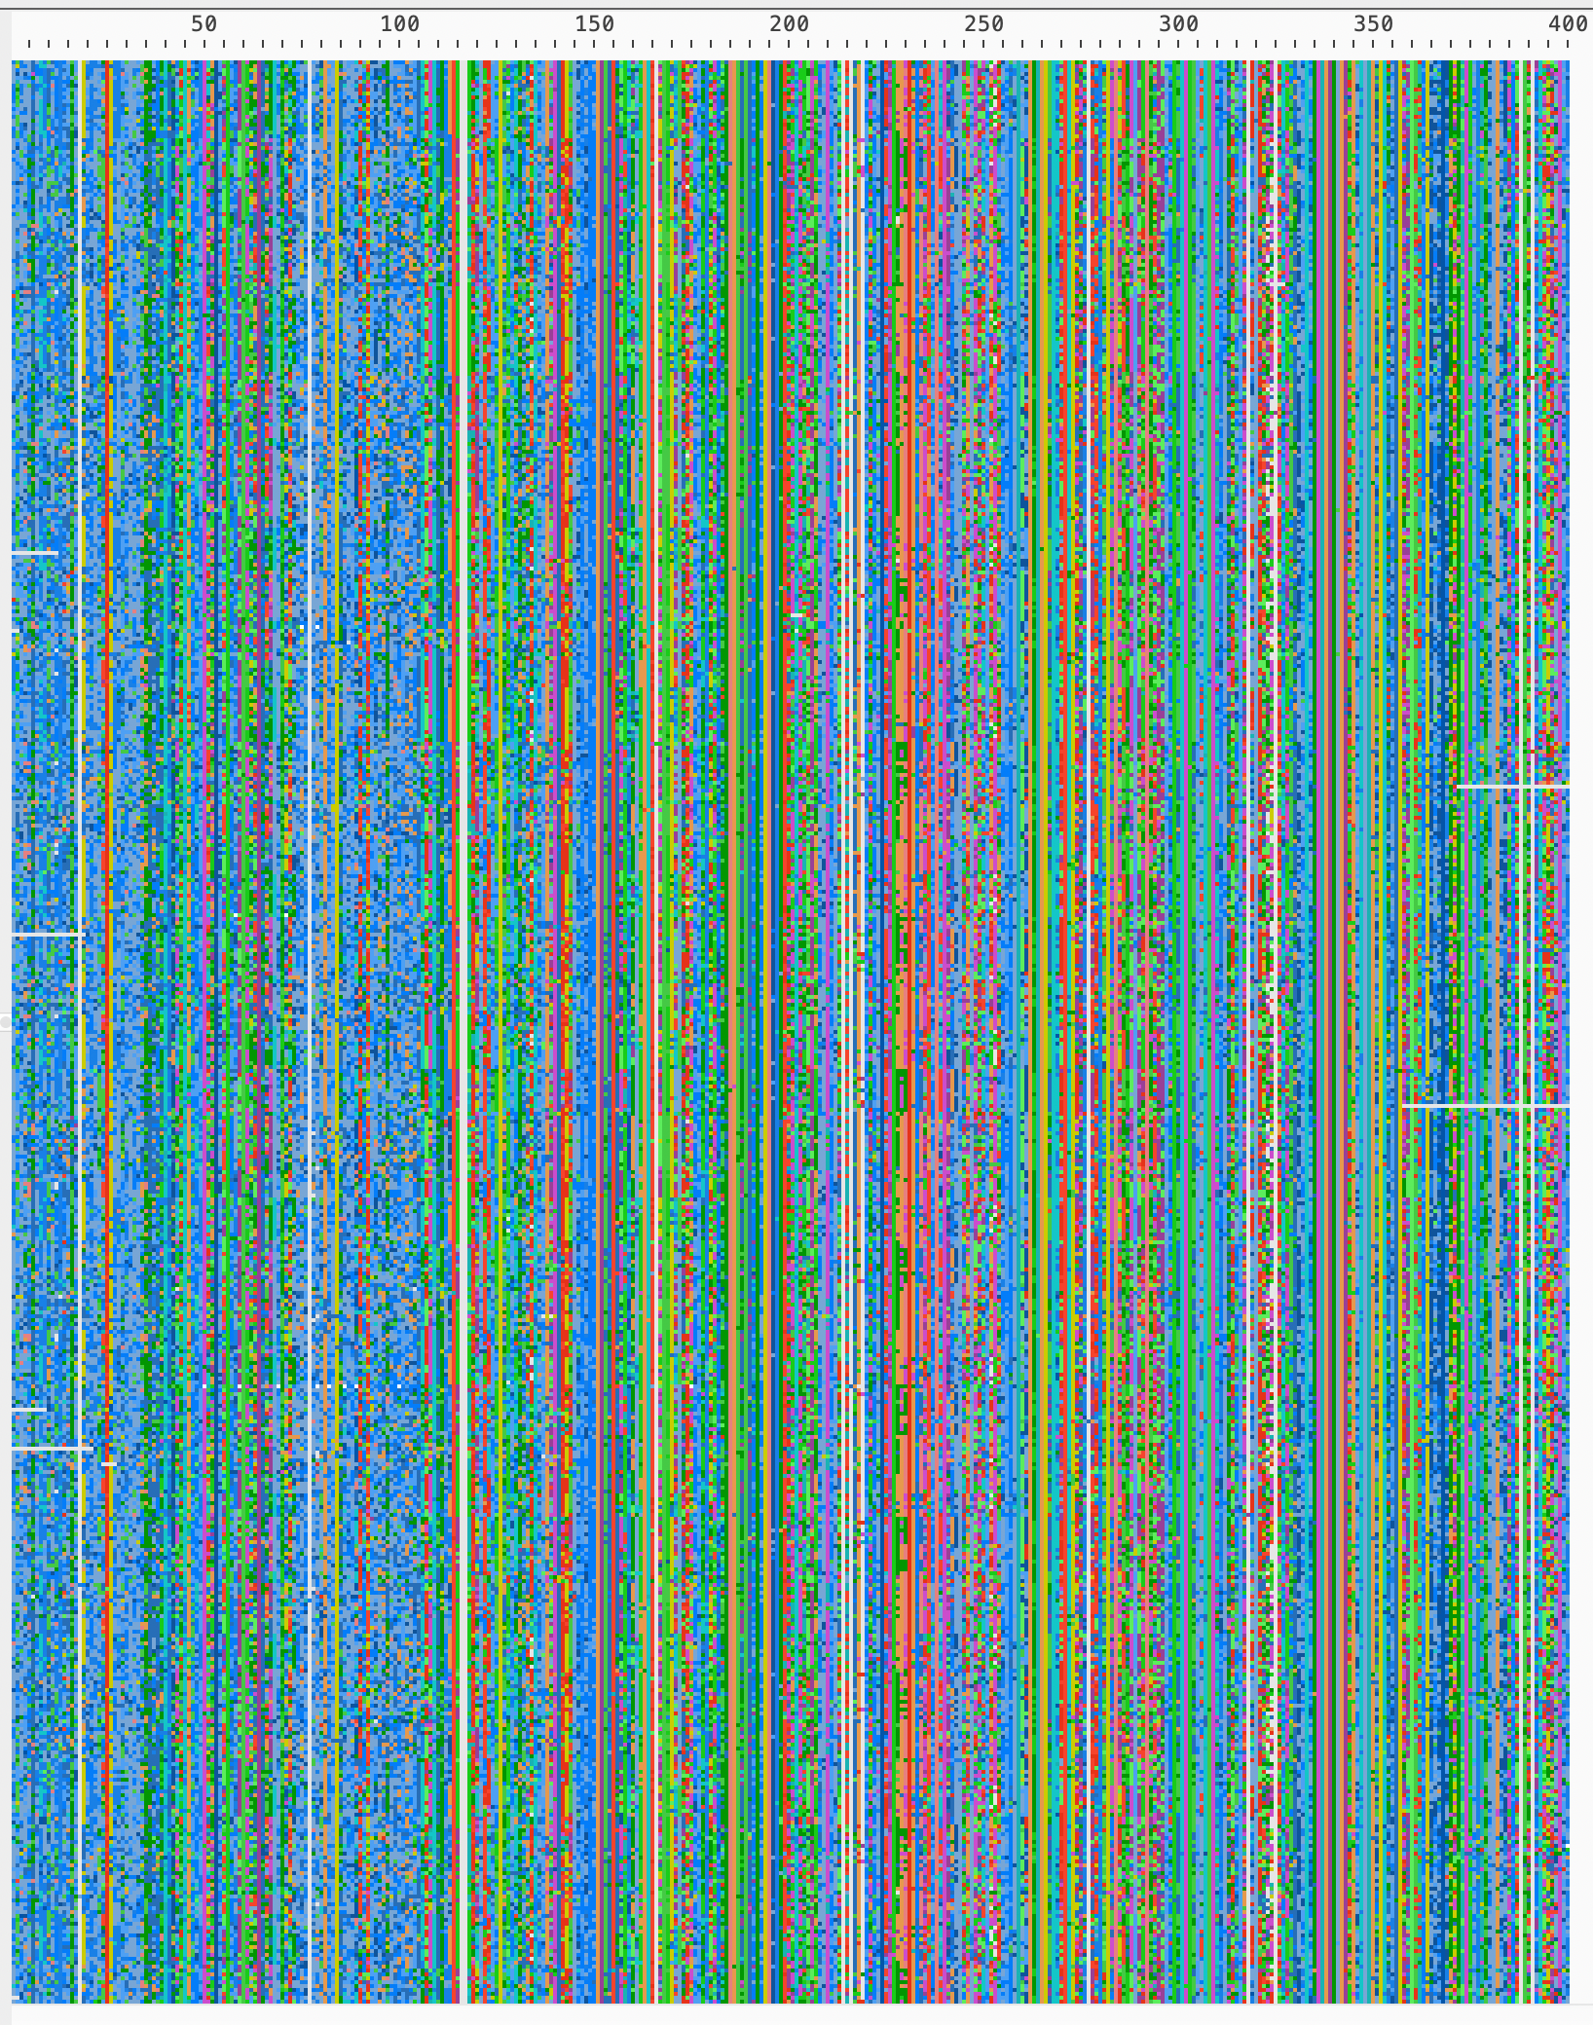
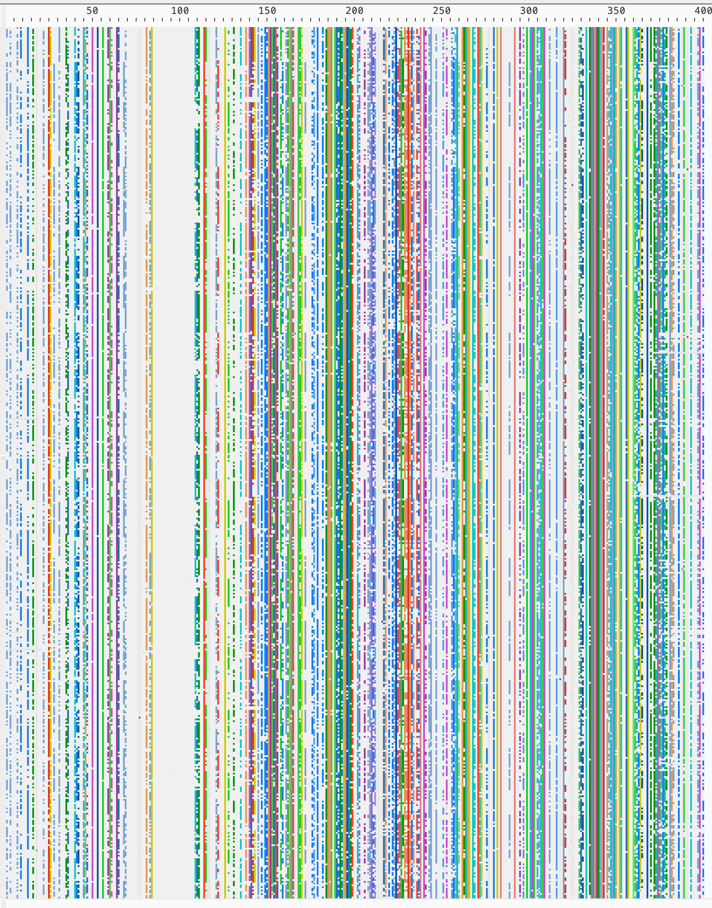
Alignment
post-trimming
Colored by majority rule concensus >

Slide 12
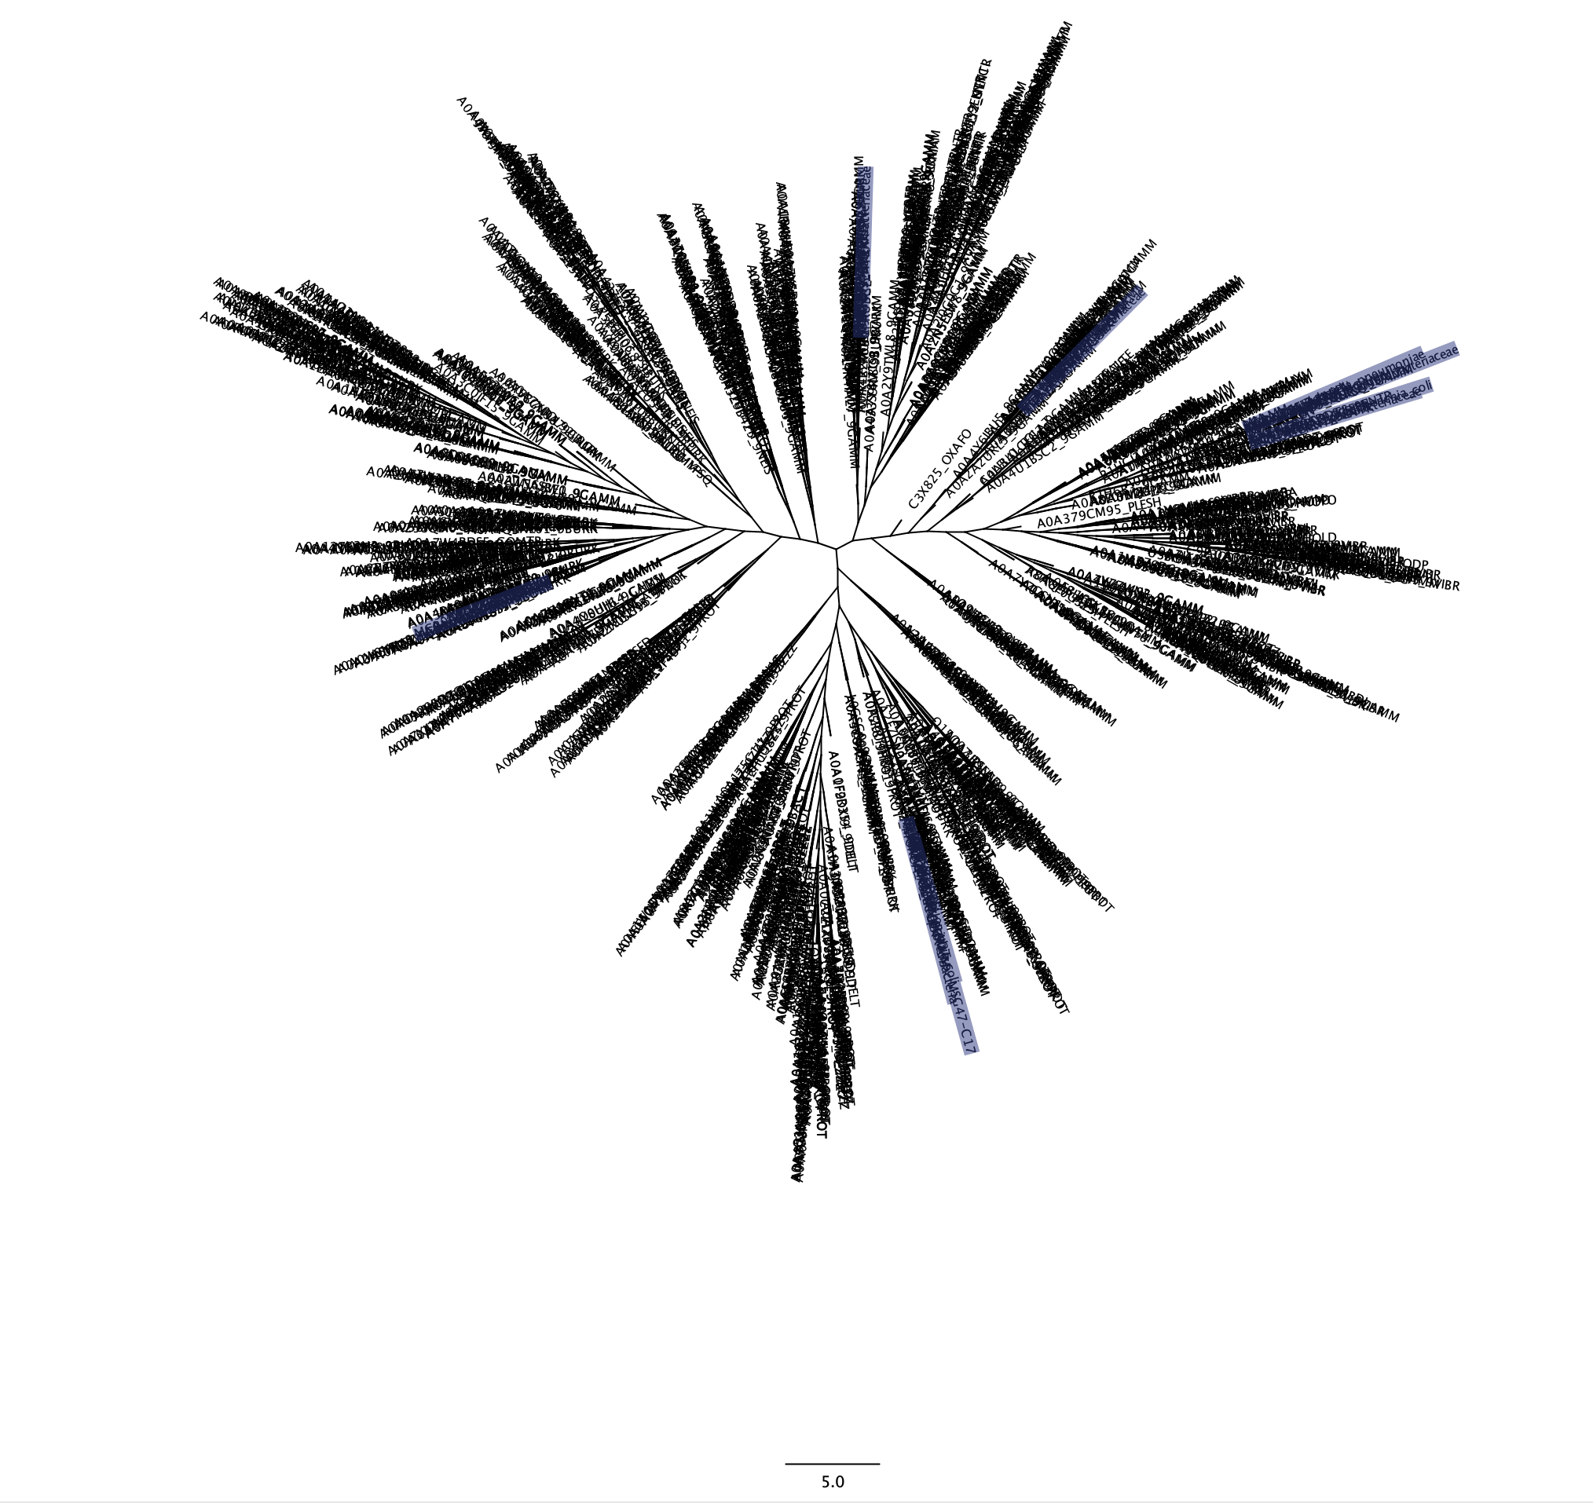
RAxML Parsimony tree from ML Distance

Slide 13
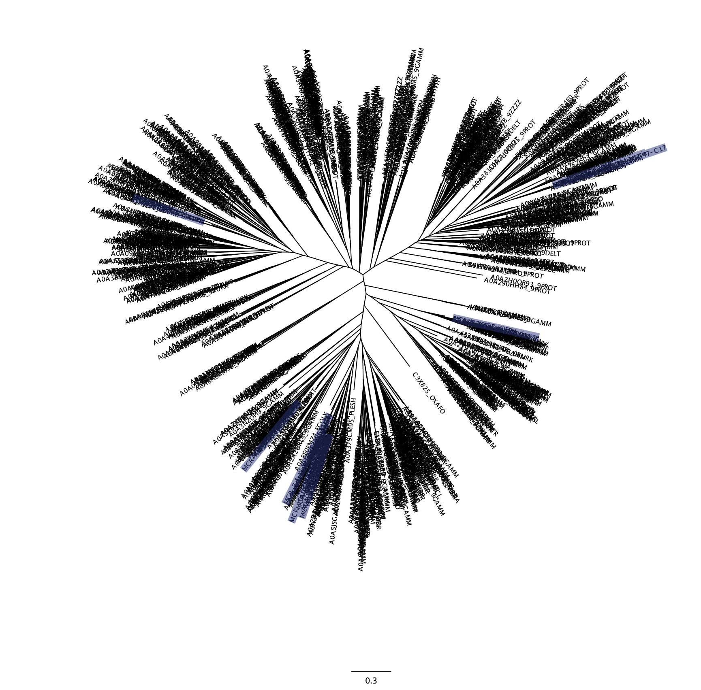
FastTree Approximate-Maximum-Likelihood
Notes:
ARGs - Experimental conserved domains and motifs.

Slide 14
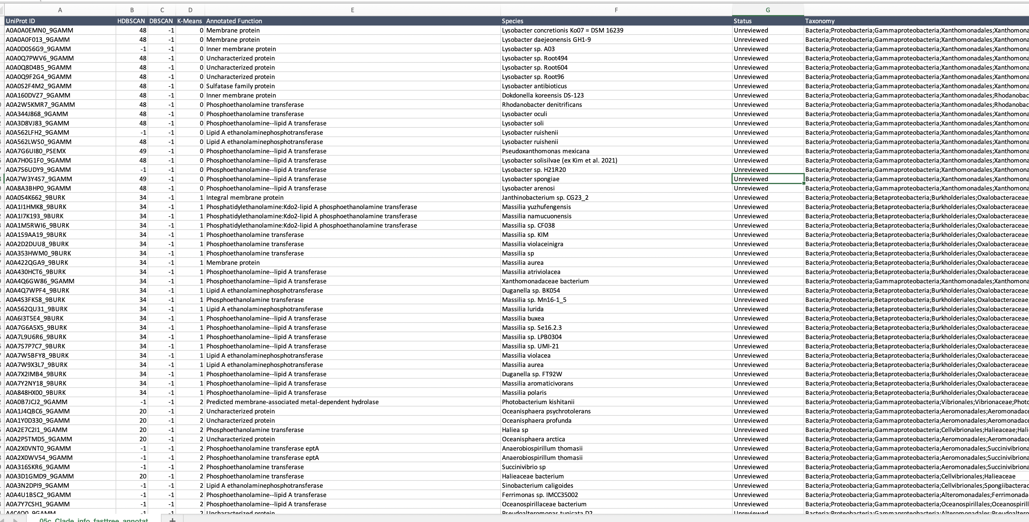
tsv output viewed in Excel

